Slide 1
e-OPEX
(Operational Expense)

Slide 2
DESCRIPTION
E-OpEx Application is a digital platform designed to help companies manage and control operational expenses (OpEx) more effectively and efficiently.
E -OPEX is Combining two technology, mobile application with Android platform for technical operation and responsive web application for controlling.

Slide 3
BACKGROUND
Companies struggle with:
Manual transaction recording
Loss of transaction evidence
Time-consuming manual reporting processes

Slide 4
OBJECTIVES
The objectives of this system are:
Improve Transaction Efficiency
Reduce Risk of Lost Evidence
Automate Reporting

Slide 5
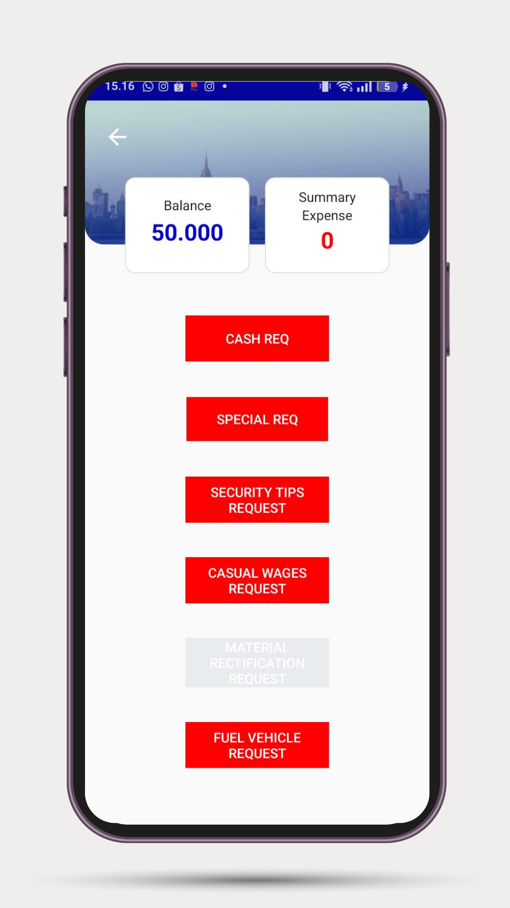
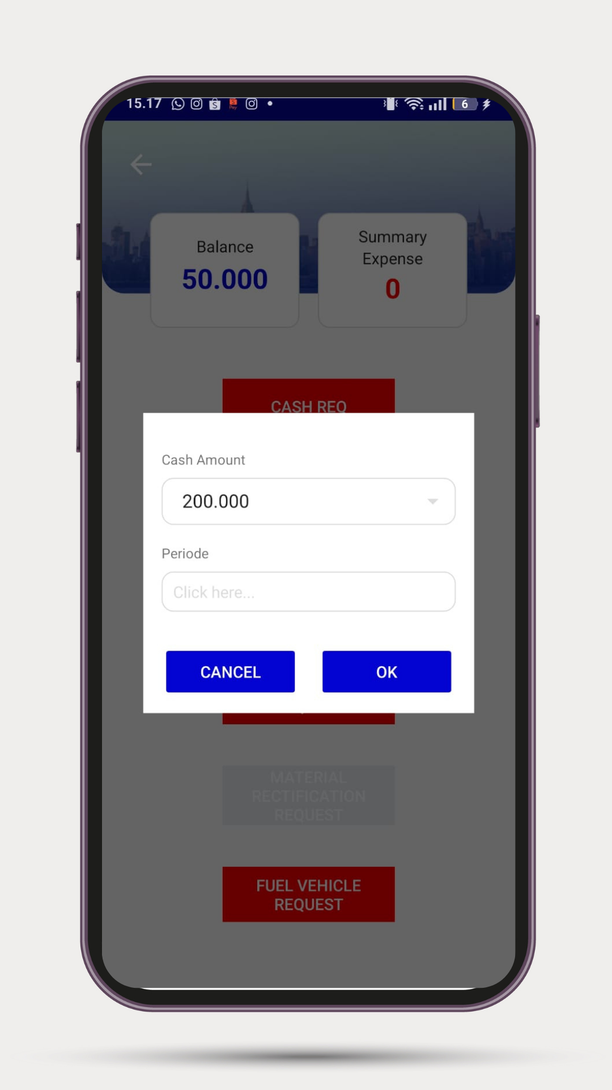
MODULES & FEATURES
REQUEST CASH:
Multiple Request Types
Configurable Request Limits
Request cash by projects
Transaction Approval
Transfer Receipt Upload
Notification Alerts

Slide 6
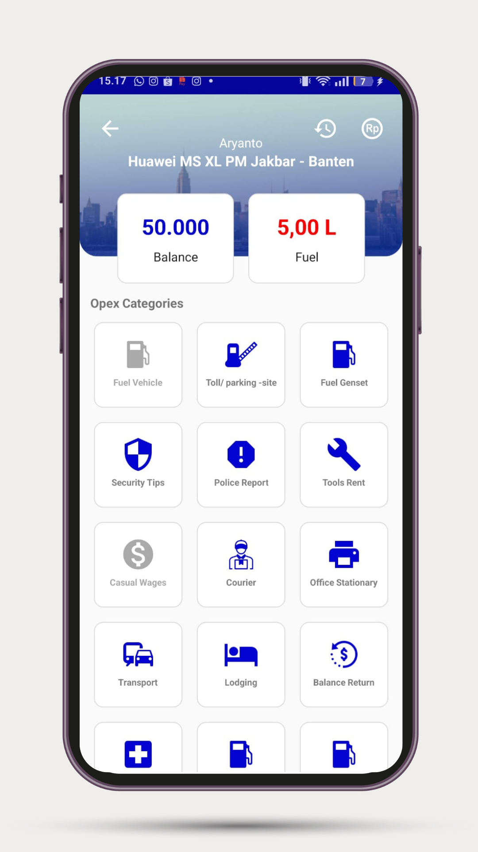
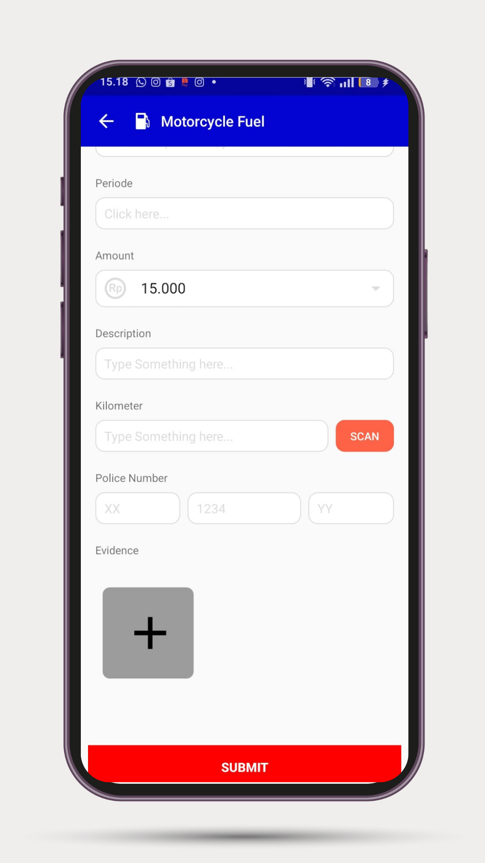
MODULES & FEATURES
EXPENSES:
Multi-Category Expense Tracking
Mileage Tracking
Take photos for evidence
Project-Based Transaction Settlement
Transaction Approval
Notification Alerts

Slide 7
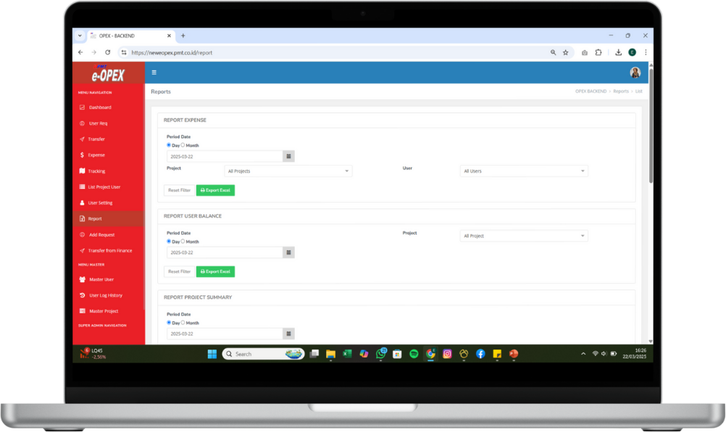
MODULES & FEATURES
REPORTING, system provides reports that can be downloaded in Excel format, including:
Fuel Consumption Report
Transfer & Expense Report
Project Summary Report
Petty Cash Report
Expense Category Report

Slide 8
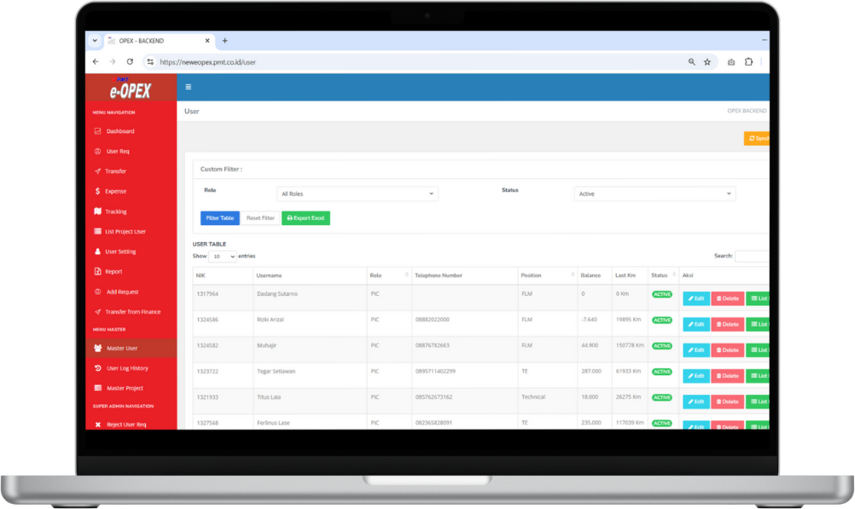
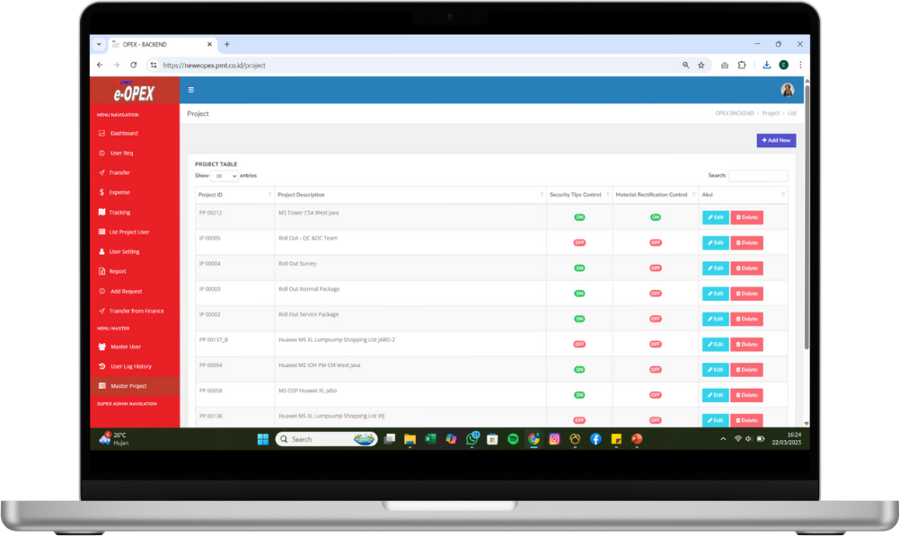
MODULES & FEATURES
MASTER DATA:
Role Master
User Master
Category Master
Activity Master
Project Master
Car Master

Slide 9


THANKS !
Contact Person:
Hermansyah
+6281286520556
hermansyah@ptezio.id
Contact Person:
Agus Sulaeman
+6281290174100
agus.sulaeman@ptezio.id

